Slide 1
World Development Statistics
Targeted Funding for "Hollow Growth" Regions
Prepared by: Mohamed Shawqi

Slide 2
Outline
Introduction
Problem statement
Data preparation methodology
Analyzing data
Identify Hollow-Growth Countries and validating results
Recommendation and Summary

Slide 3
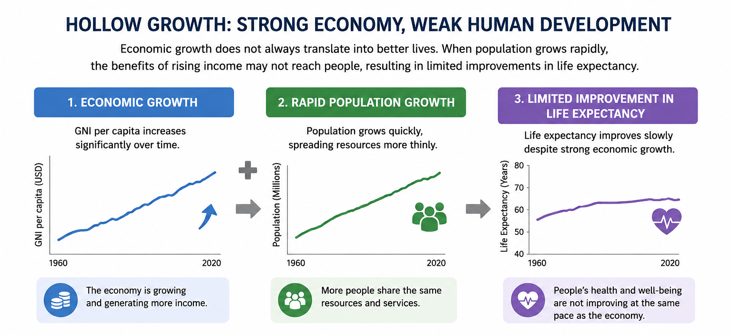
What is Hollow Growth regions?

Slide 4
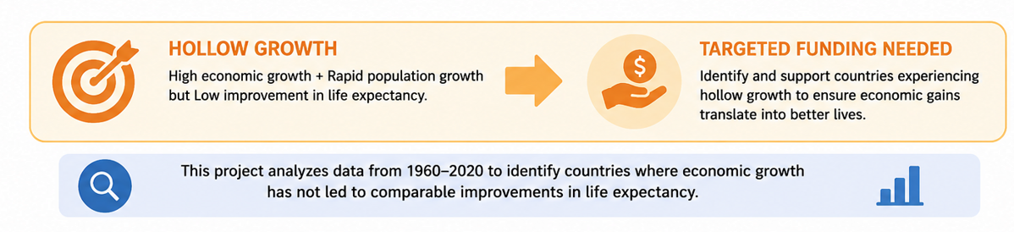

Slide 5
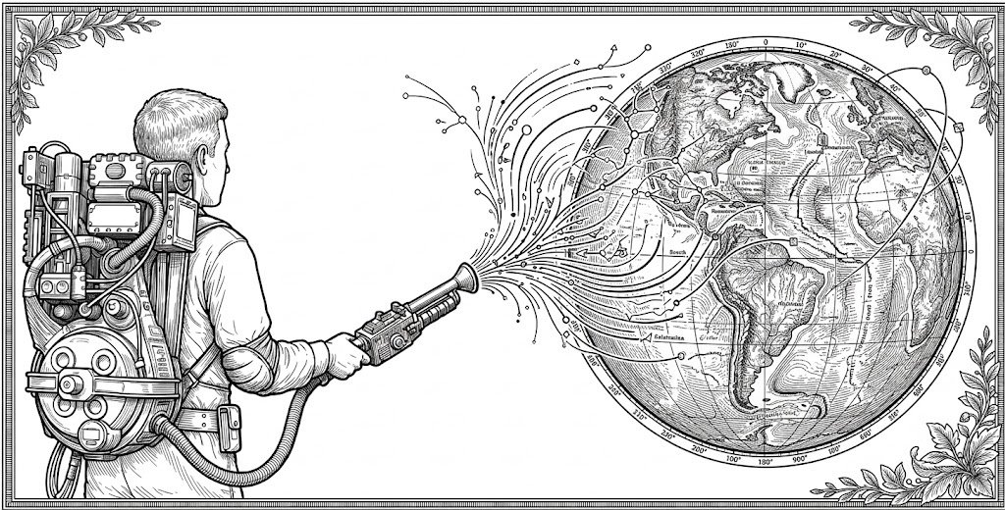
Data preparation methodology
Three Gapminder World Development Statistics datasets were used:
Population
GNI per Capita in USD
Life Expectancy
It covers 197 countries with current and predicted futuristic data
ranged from year 1800 → 2100.

Slide 6
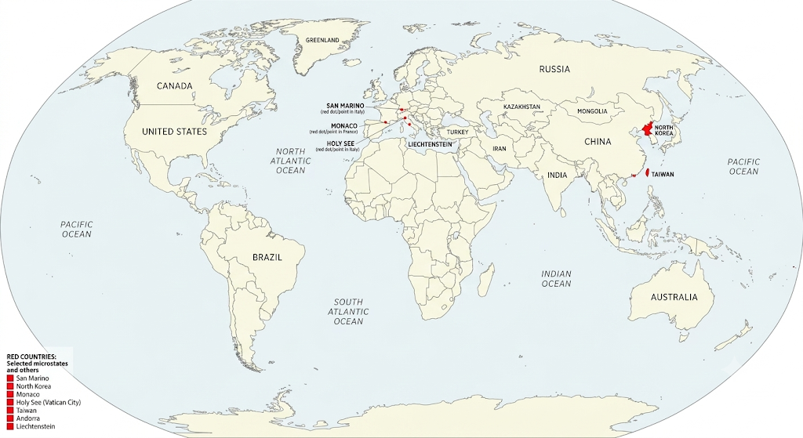
To prevent getting biased results and to ensure fair comparison, seven countries were dropped from the datasets due lack in required data:
Around 80% of the overall data was retained.
San Marino
North Korea
Monaco
Holy See
Taiwan
Andorra
Liechtenstein

Slide 7
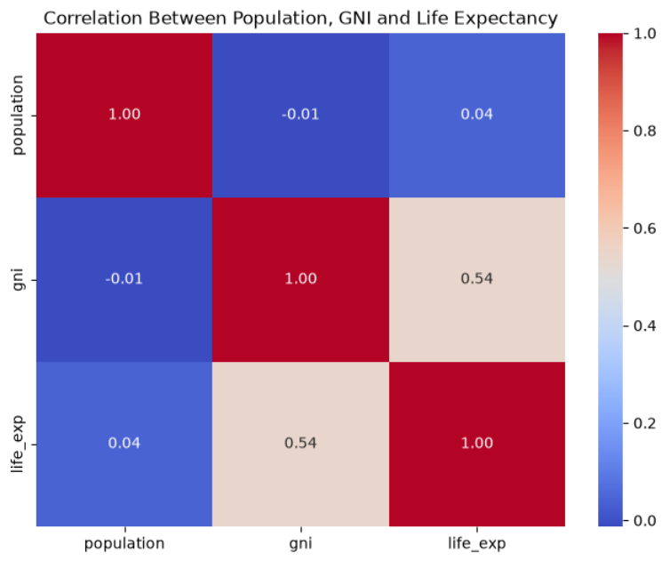
Analyzing data

Slide 8
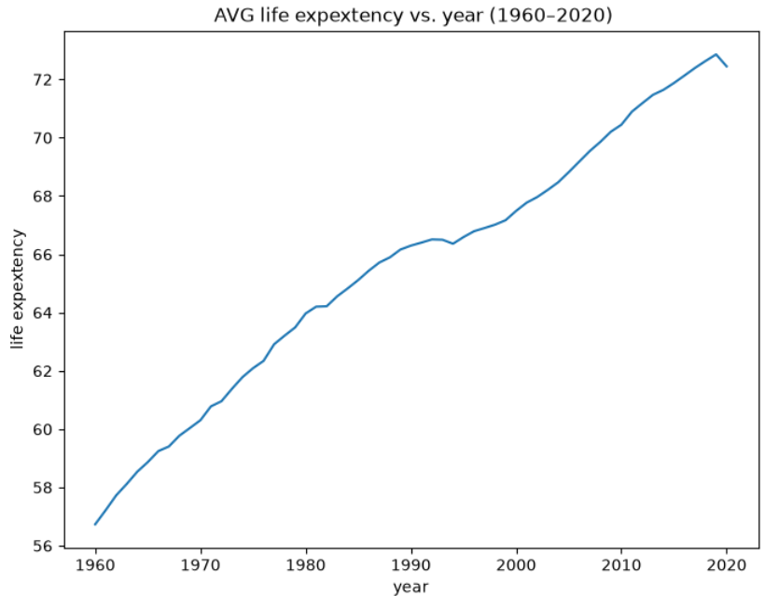
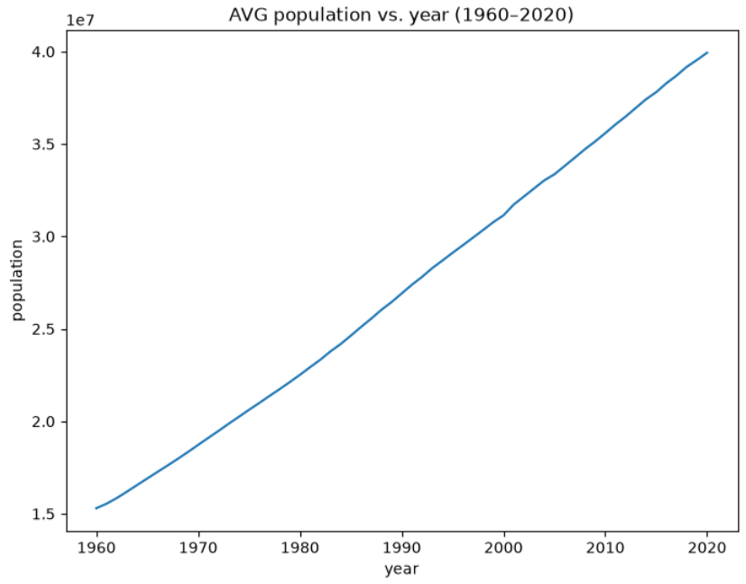
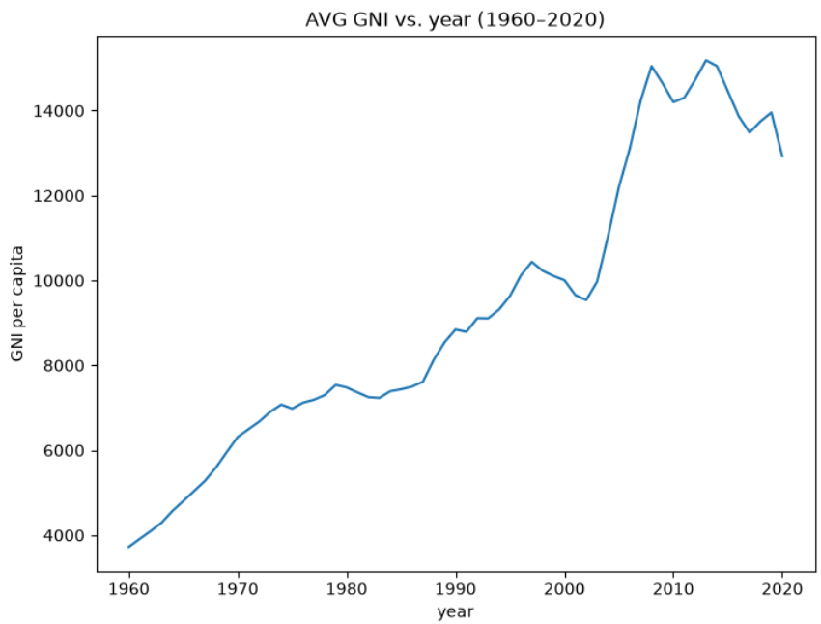
Analyzing data

Slide 9
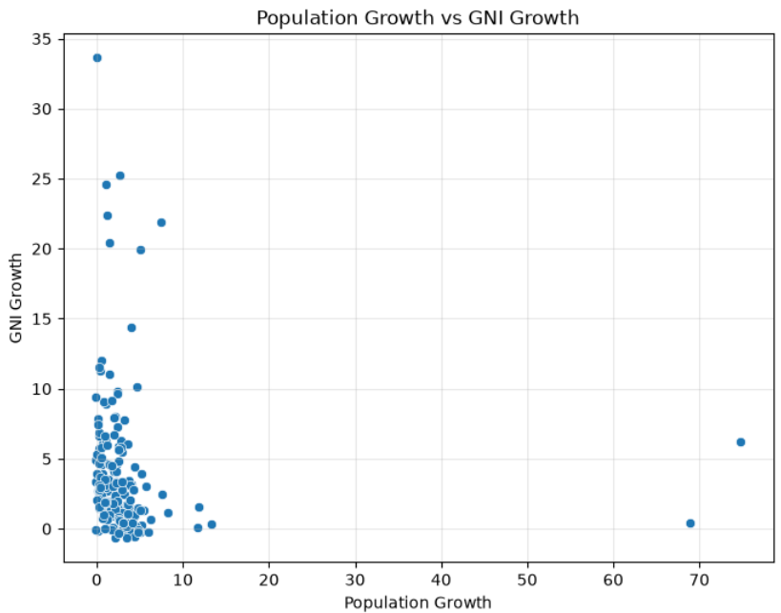
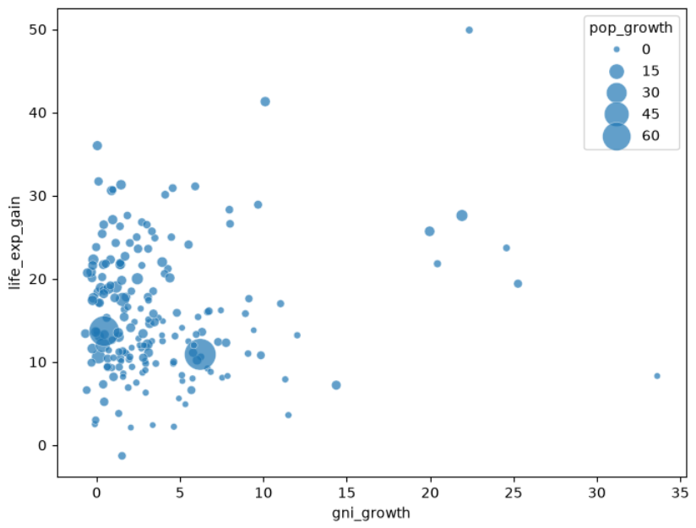
Analyzing data

Slide 10
Top 5 GNI per capita growth rate countries
country | pop_growth | life_exp_gain | gni_growth
Romania | 0.05 | 8.3 years | 33.62
Singapore | 2.69 | 19.4 years | 25.27
South Korea | 1.01 | 23.7 years | 24.58
China | 1.17 | 49.9 years | 22.35
Oman | 7.45 | 27.6 years | 21.91
Top 5 life expectancy gain countries
country | pop_growth | life_exp_gain | gni_growth
China | 1.17 | 49.9 years | 22.35
Maldives | 4.61 | 41.3 years | 10.11
Cameroon | 4.18 | 36 years | 0.04
Iran | 3.08 | 31.7 years | 0.11
Yemen | 4.83 | 31.3 years | 1.46
Top 5 population growth rate countries
country | pop_growth | life_exp_gain | gni_growth
Qatar | 74.82 | 10.9 years | 6.21
United Arab Emirates | 68.85 | 13.7 years | 0.45
Kuwait | 13.3 | 12 years | 0.36
Jordan | 11.85 | 17.5 years | 1.55
Djibouti | 11.69 | 10.6 years | 0.11

Slide 11
Statistic table
 | gni_growth | pop_growth | Life_exp_gain
count | 190.000000 | 190.000000 | 190.000000
mean | 3.830053 | 3.096053 | 15.787947
std | 4.960800 | 7.426849 | 7.727380
min | -0.680000 | -0.160000 | -1.300000
25% | 0.937500 | 0.680000 | 10.425000
50% | 2.495000 | 2.125000 | 13.950000
75% | 4.900000 | 3.507500 | 20.675000
max | 33.620000 | 74.820000 | 49.900000

Slide 12
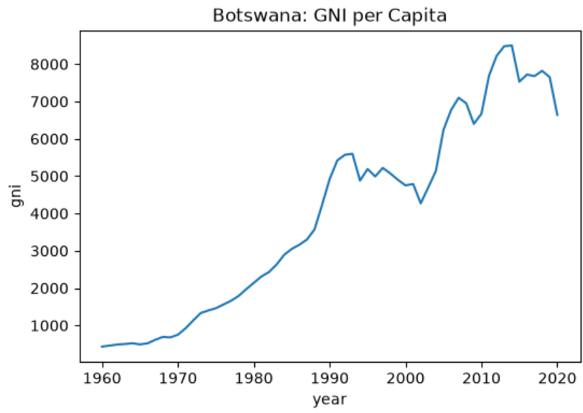
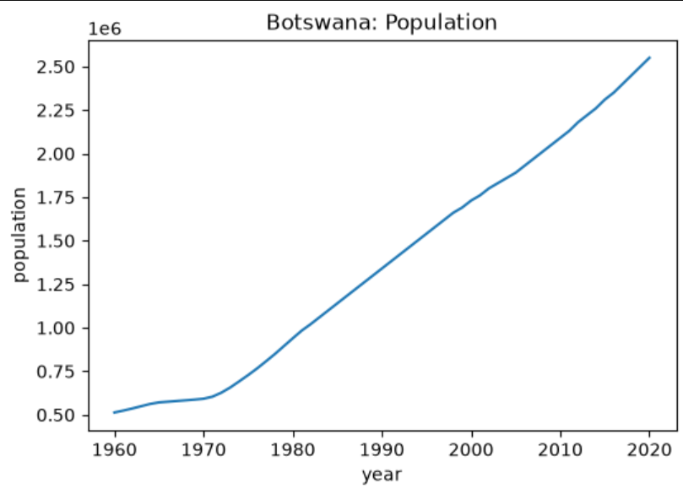
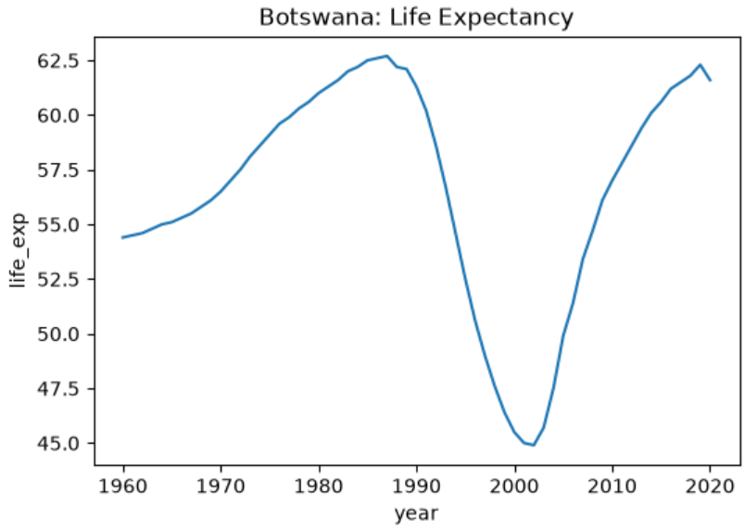
Results
Hollow Growth countries
country | population_1960 | population_2020 | life_exp_1960 | life_exp_2020 | gni_1960 | gni_2020 | pop_growth | life_exp_gain | gni_growth
Botswana | 513000 | 2550000 | 54.4 years | 61.6 years | 432 | 6640 | 3.97 | 7.2 years | 14.37

Slide 13

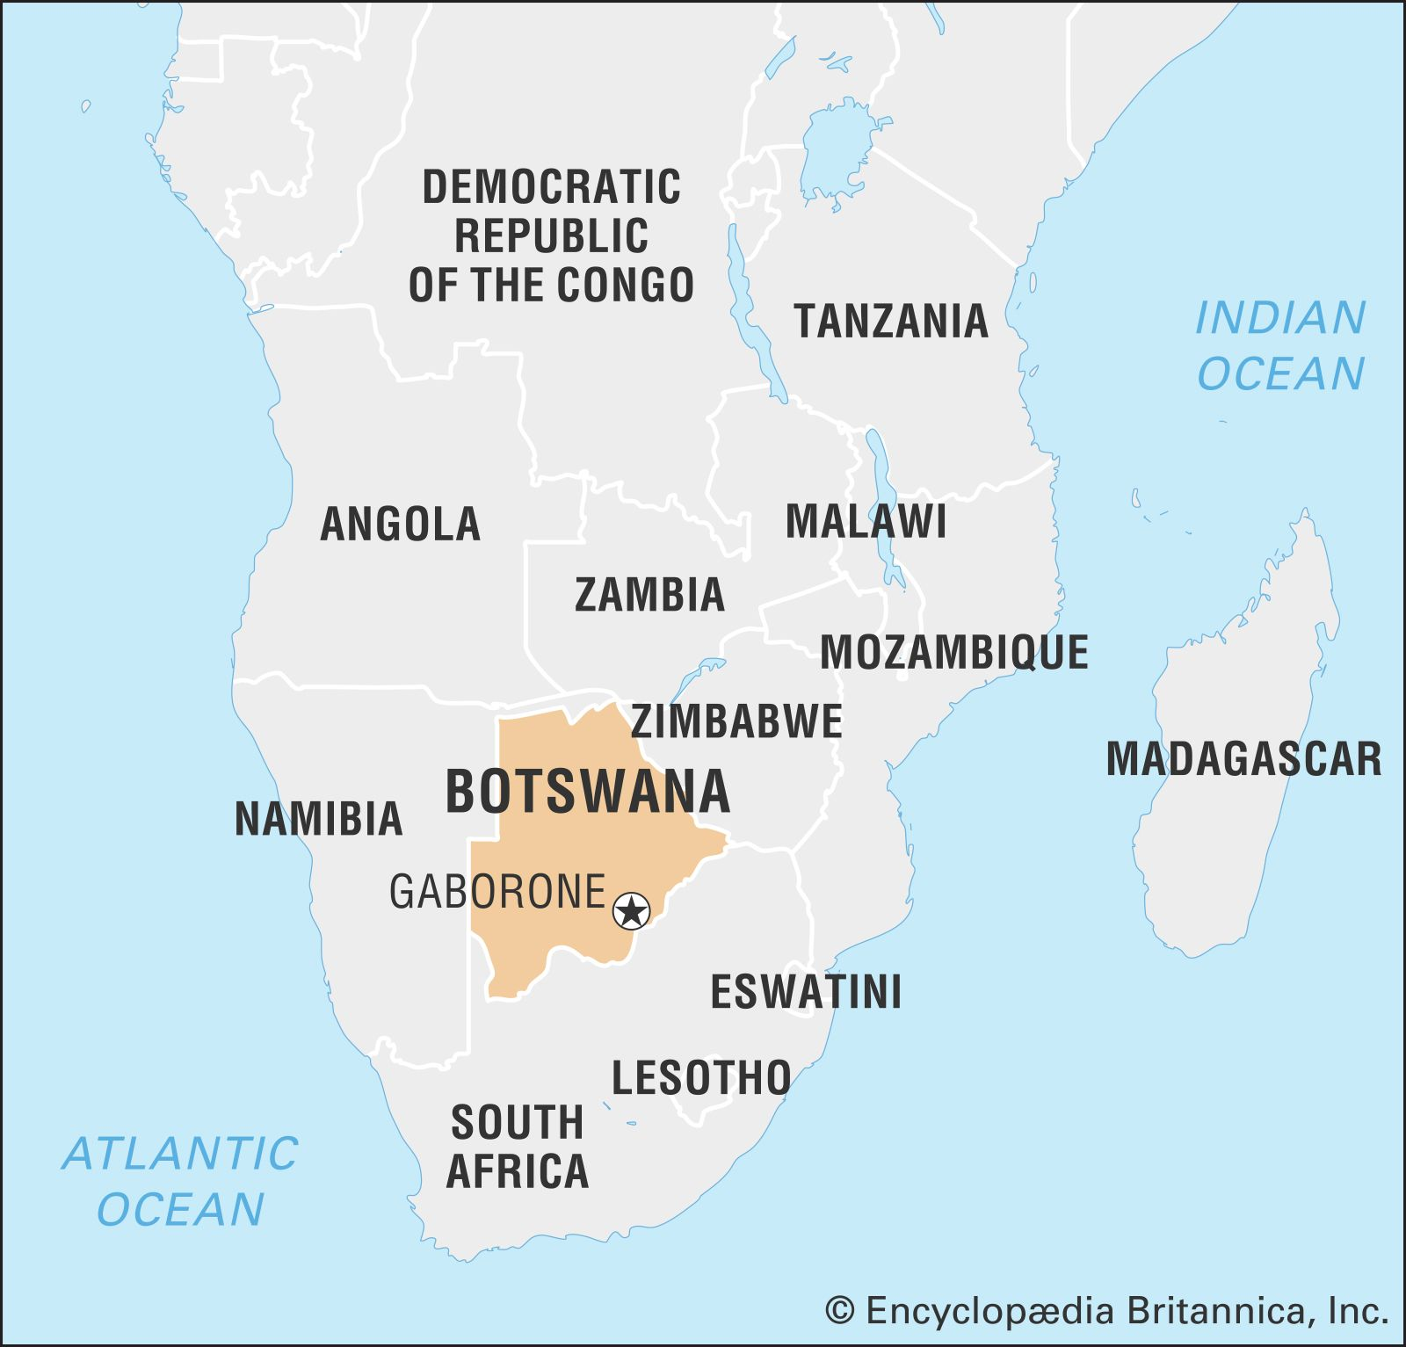
Recommendation
Botswana Flag
Based on combining historical trend analysis, correlation analysis and the data filtering methodology, it shows that Botswana is the strongest candidate for the target development fund.

Slide 14
Summary
High Economic growth does is not always translated into better lives. By combining historical trend analysis, correlation analysis, and applying filtration methodology, the project successfully highlighted potential hollow-growth countries, which in our case was Botswana. These findings provide the Policy Steering Committee with evidence-based candidates for the proposed $100 million intervention fund, ensuring that resources are directed toward countries experiencing stalled human development despite economic progress.

